Slide 1
Electrical safety hazards
Look at some of the following images and discuss the following questions:
Why is the situation dangerous?
What might happen?
How could you minimise the risk of someone being harmed?

Slide 2
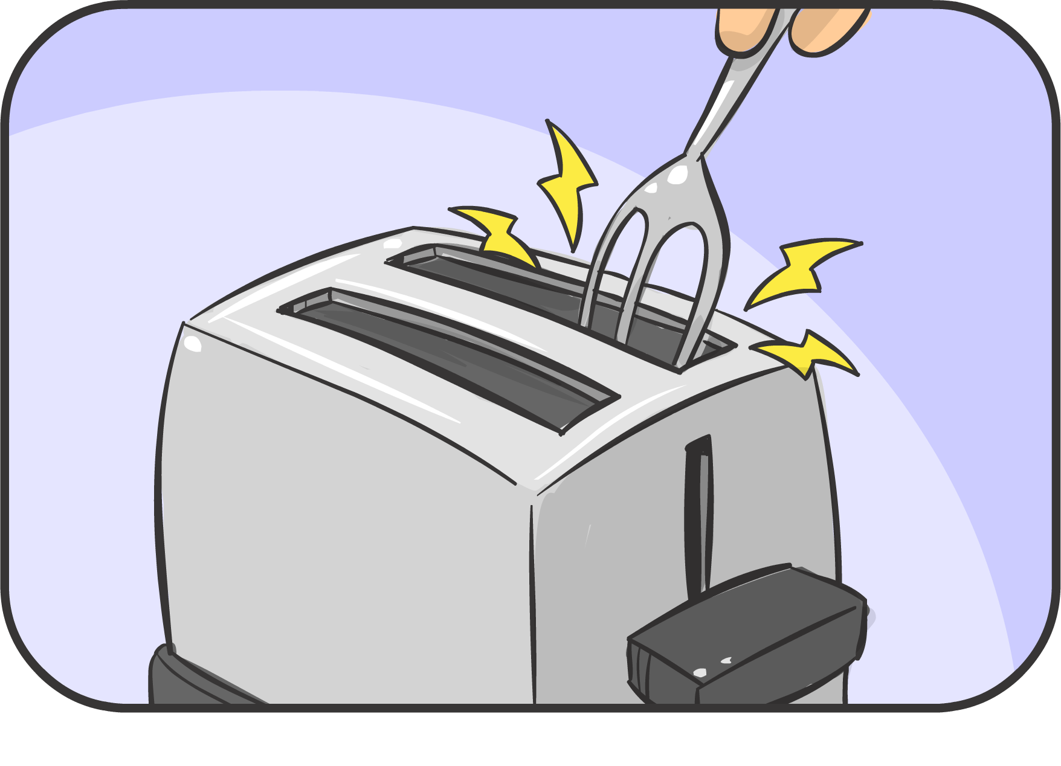
Why is the situation dangerous?
What might happen?
How could you minimise the risk of someone being harmed?
Notes:
Student responses may include:
Why is the situation dangerous? The fork is made of metal which means it conducts electricity. The person holding it will get an electrical shock.
What might happen? The person holding the fork may get injured badly from the electrical shock or die.
How could you minimise the risk of someone being harmed? Tell an adult so they can supervise. If a piece of toast is stuck in the toaster, unplug the toaster from the power point at the wall so no electricity is connected to the toaster. Then use a plastic utensil such as a plastic fork or plastic spatula (which are insulators) to remove the toast.

Slide 3
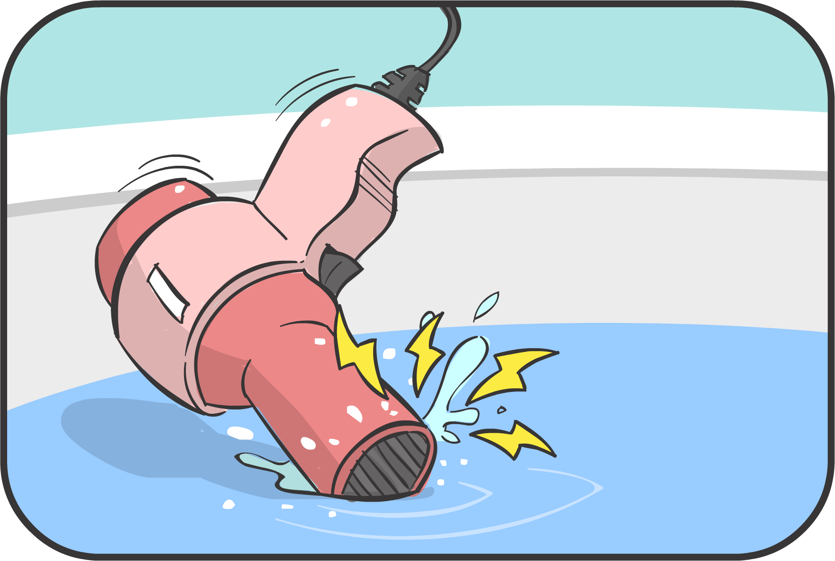
Why is the situation dangerous?
What might happen?
How could you minimise the risk of someone being harmed?
Notes:
Why is the situation dangerous? Water conducts electricity so the hairdryer and water are now very dangerous because they are possibly conducting electricity.
What might happen? If someone touches the hairdryer or the water, they will receive a very bad electrical shock or die.
How could you minimise the risk of someone being harmed? Tell an adult and get their help. Turn off the hairdryer at the switch on the wall. Pull the plug out of the power point. Remove the hairdryer from the water and throw it away.

Slide 4
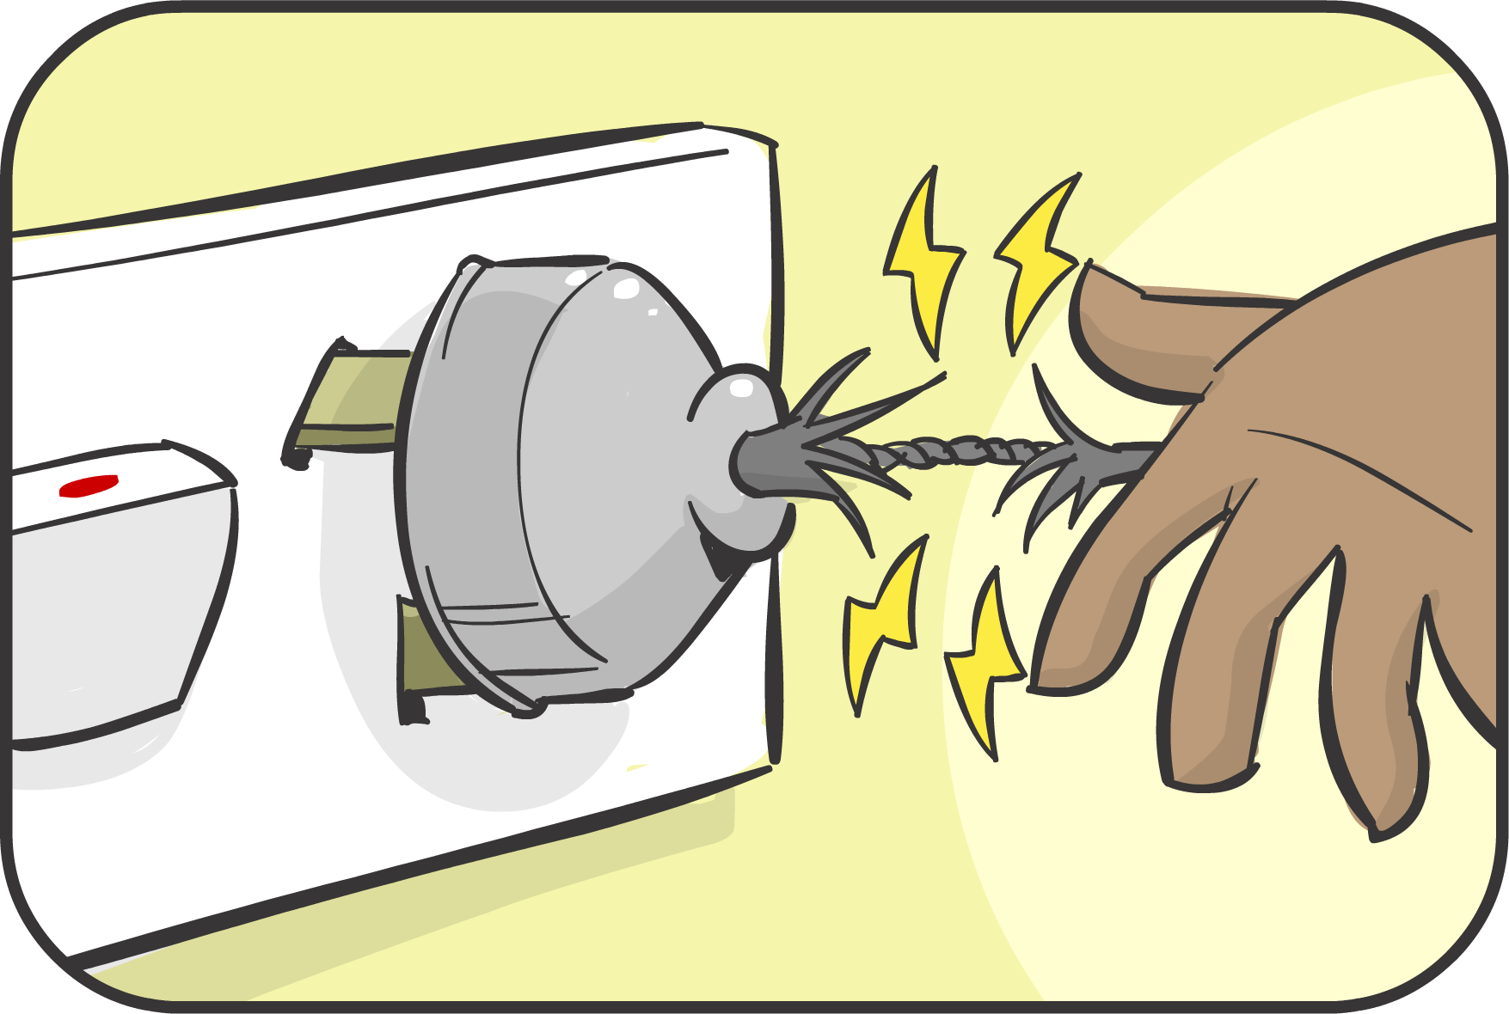
Why is the situation dangerous?
What might happen?
How could you minimise the risk of someone being harmed?
Notes:
Why is the situation dangerous? The plastic coating which acts as an insulator to stop the electricity is broken and the metal wires are exposed. It is plugged in and turned on so, electricity is flowing.
What might happen? If someone touched the metal wires, they will receive an electrical shock and may die.
How could you minimise the risk of someone being harmed? Tell an adult so they can supervise. Turn the plug off at the wall and then remove it from the power point. Have the cord fixed so that the electrical wires are properly insulated.

Slide 5
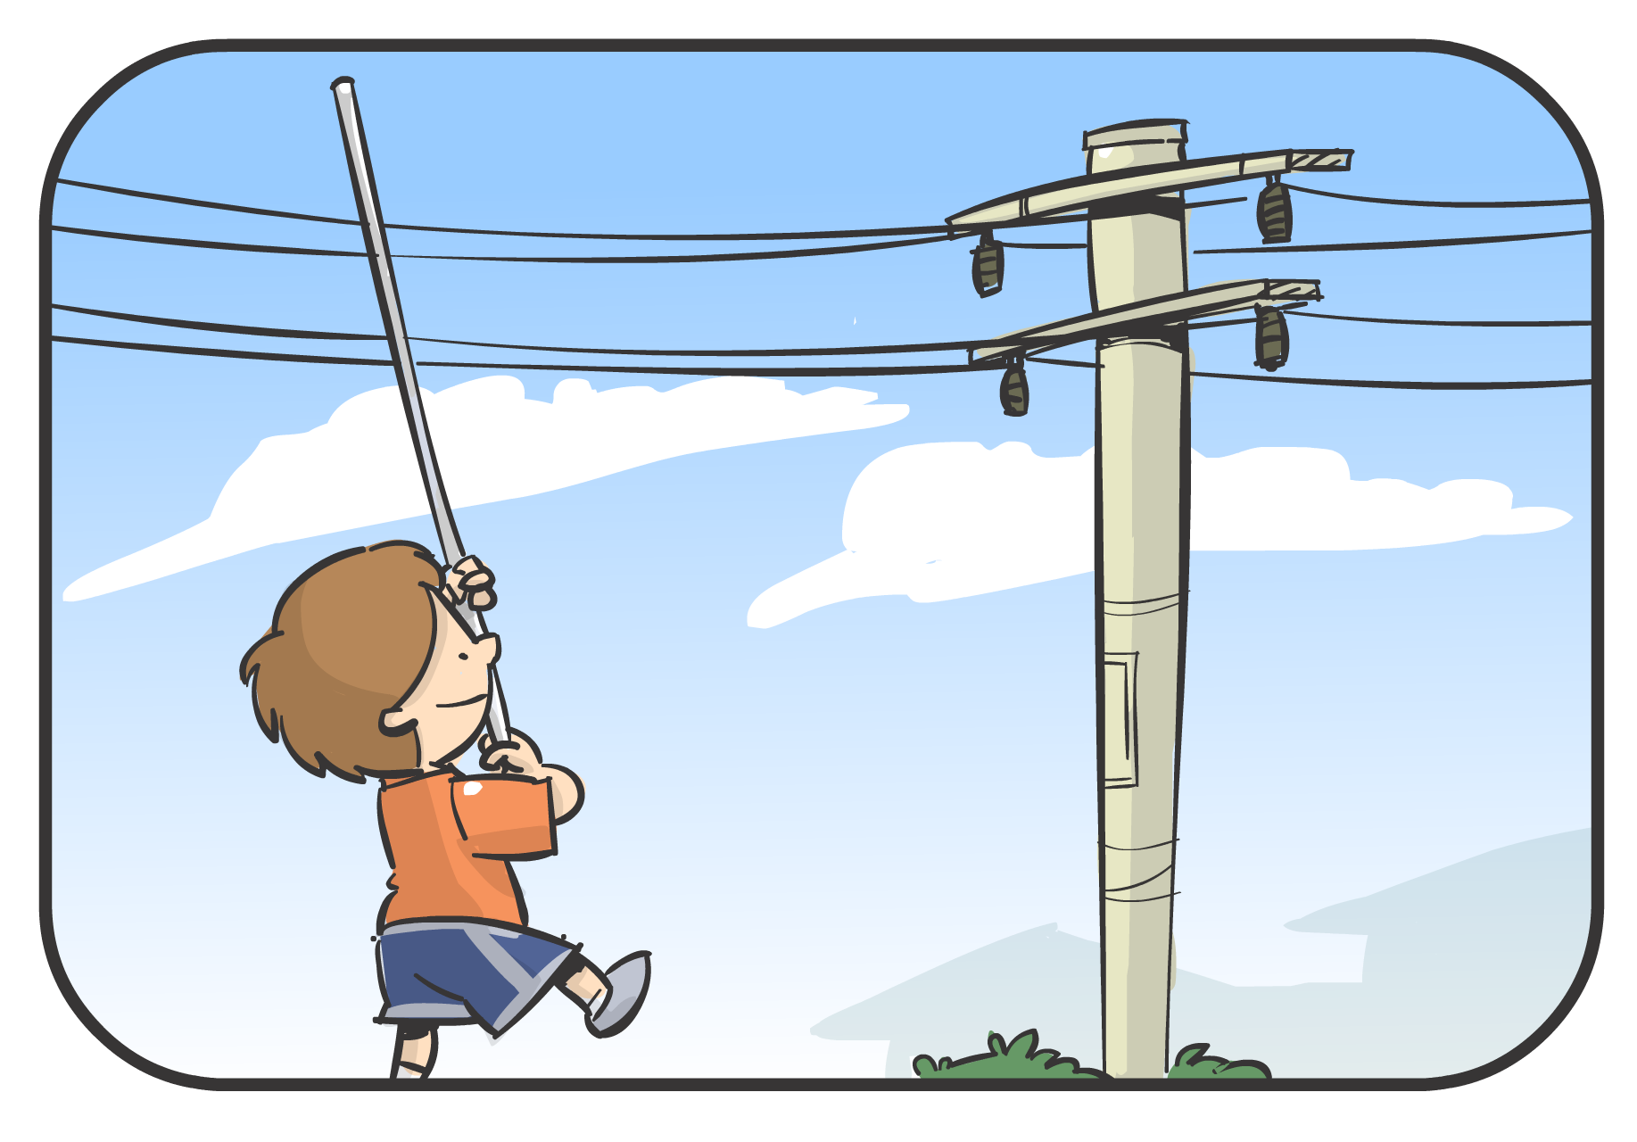
Why is the situation dangerous?
What might happen?
How could you minimise the risk of someone being harmed?
Notes:
Why is the situation dangerous? The child is carrying a long metal pole near overhead power lines.
What might happen? The metal pole may touch the power lines and conduct electricity and electrocute the boy.
How could you minimise the risk of someone being harmed? Tell the boy of the dangers of carrying metal poles near power lines and make sure he plays somewhere else.

Slide 6
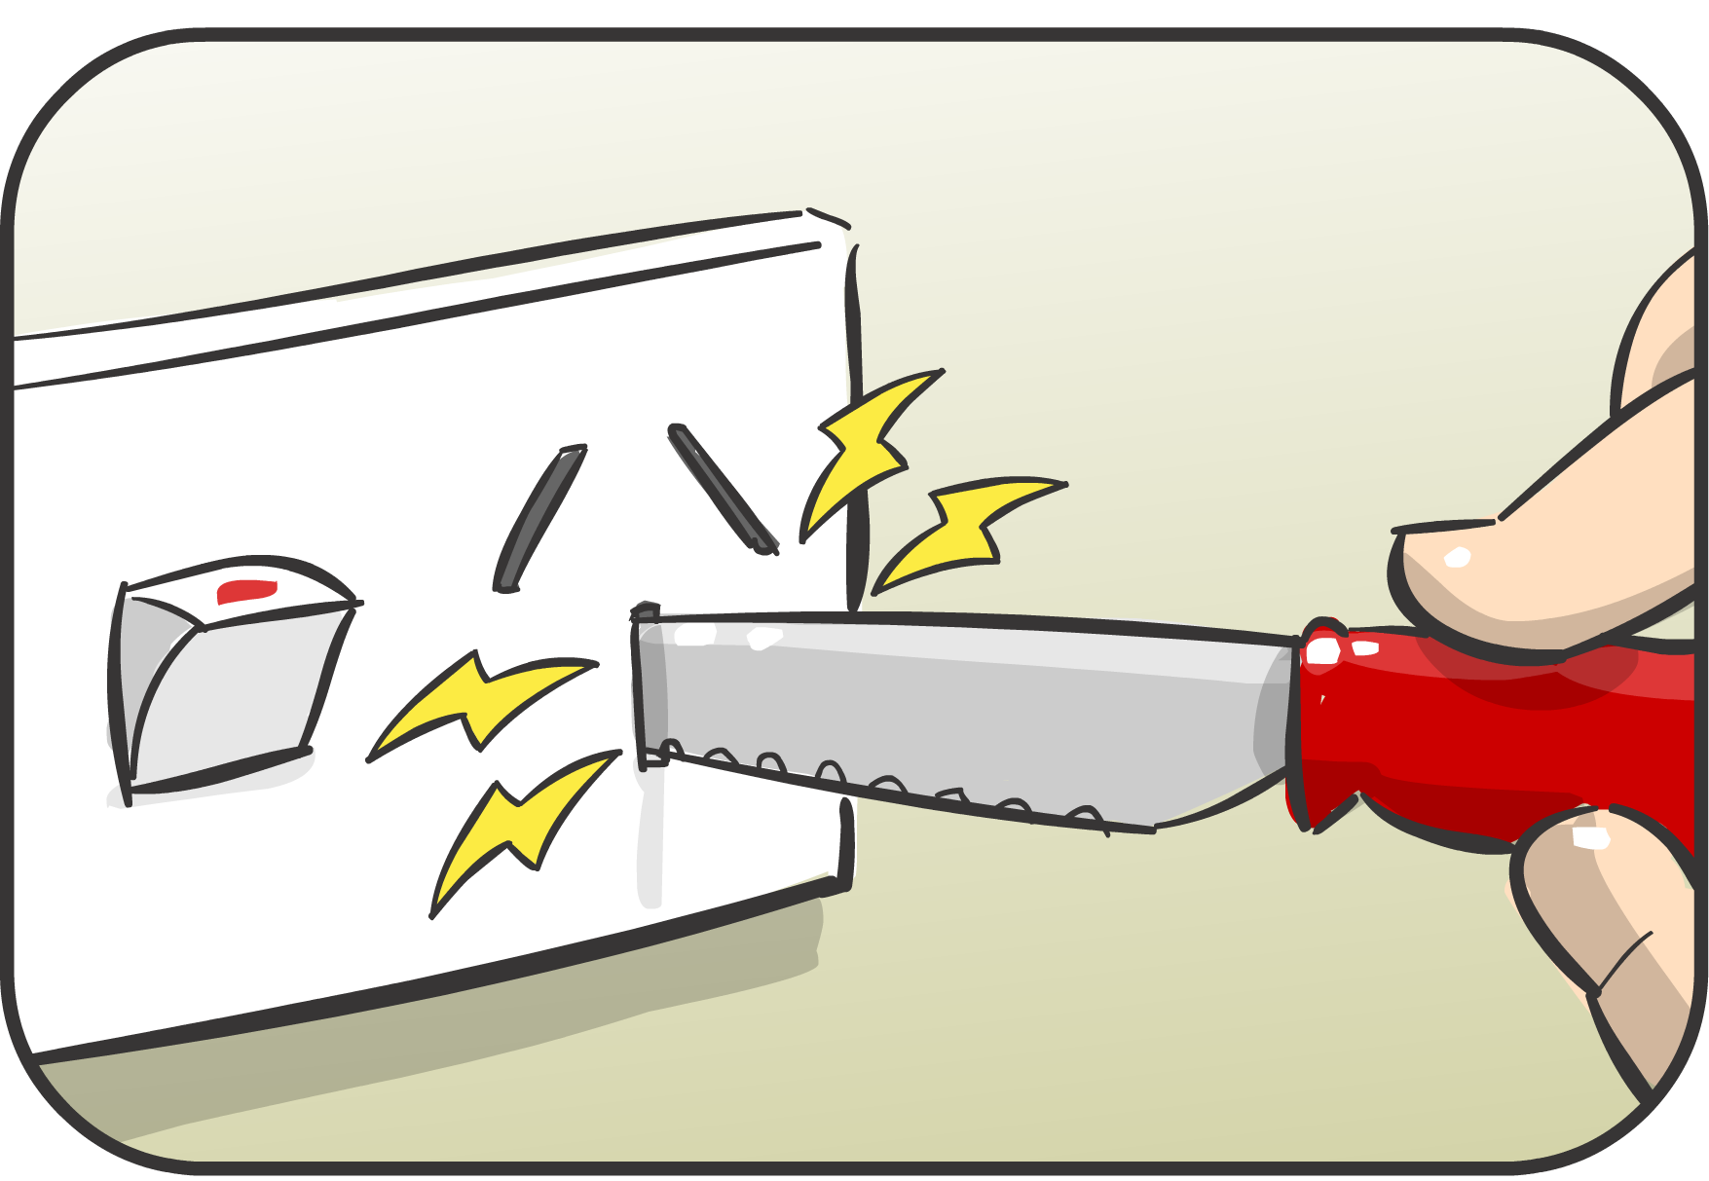
Why is the situation dangerous?
What might happen?
How could you minimise the risk of someone being harmed?
Notes:
Why is the situation dangerous? The power point is switched on so electricity will conduct into the knife because the knife is metal.
What might happen? The person holding the knife may receive an electrical shock and possibly die. Even though the handle looks like it is plastic, if the electrical current is large enough, it will conduct through the plastic handle.
How could you minimise the risk of someone being harmed? Turn off power points not being used and put safety plugs into the holes so strange objects can’t be put into them.

Slide 7
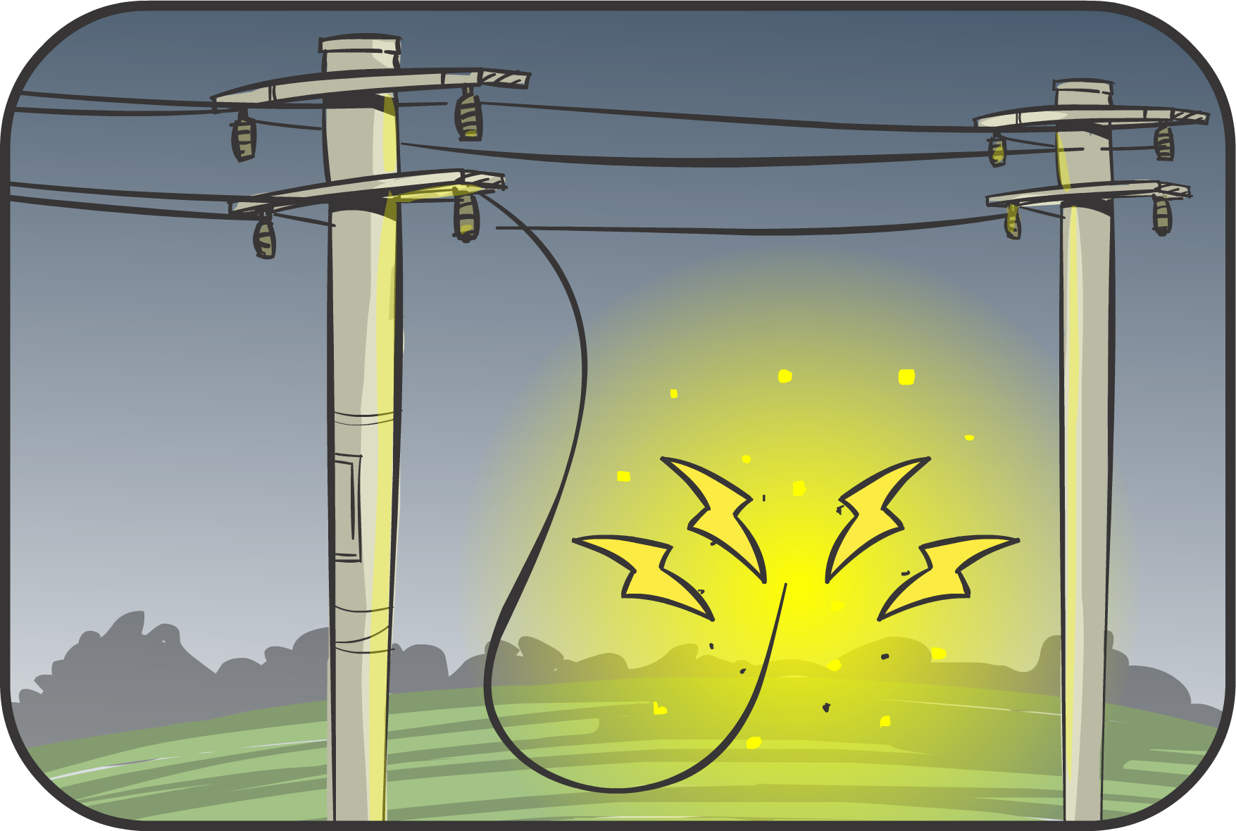
Why is the situation dangerous?
What might happen?
How could you minimise the risk of someone being harmed?
Notes:
Why is the situation dangerous? One of the power lines has fallen down.
What might happen? It could electrocute someone if it touched them.
How could you minimise the risk of someone being harmed? Tell an adult so they can call the electricians who fix power lines. Make sure that no one touches the fallen wire.

